Slide 1

It’s Time For:
Jeopardy

Slide 2
Name that Place

Slide 3
People

Slide 4
Quotes

Slide 5
Battles

Slide 6
Years

Slide 7
Sides and Viewpoints

Slide 8
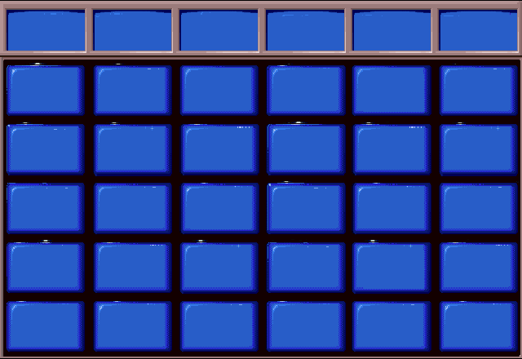
Name that Place
People
Quotes
Battles
Years
Sides and Viewpoints
$100
$100
$100
$100
$100
$100
$200
$200
$200
$200
$200
$200
$300
$300
$300
$300
$300
$300
$400
$400
$400
$400
$400
$400
$500
$500
$500
$500
$500
$500
Notes:
Round One should contain one “Daily Double” question. To insert the “Daily Double Screen”, follow these steps:
1. Select the desired button on this slide by clicking on it.
Click on SLIDE SHOW ➔ ACTION SETTINGS
Make a note of which slide the HYPERLINK is currently set to.
In the “Action Settings” dialogue box, change the HYPERLINK to “Daily Double Round 1”.
Click OK
6. Now go to Slide “Daily Double Round 1” in this presentation, and follow the directions in the “Notes” section

Slide 9
Name that Place

Slide 10
1-100
1 - 100
This place was where Santa Anna was captured by the Texans
$100

Slide 11
Where is San Jacinto?

Slide 12
1-200A
1 - 100
Juan Seguin left this place which was doomed to fall
$200

Slide 13
Where is the Alamo?

Slide 14
300
Juan N. Almonte was captured here
$300

Slide 15
Where is San Jacinto?

Slide 16
1-400
This place was where the Convention of 1836 took place
$400

Slide 17
Where is Washington on the Brazos?

Slide 18

Daily Double Round 1
Daily
Double!!
Notes:
To Complete the Daily Double Sequence for Round One:
Click on any blue area on the slide that is currently displayed
Click on Slide Show ➔ Action Settings
The Action Settings Dialog Box will be displayed.
You will see that the HYPERLINK is currently set to “Slide 8”
Change the HYPERLINK so that it is set to the slide number you made note of previously
Click OK until the Action Settings Dialog Box disappears
Save
Return to Slide 8 and select View ➔ Slide Show.
Test your Daily Double button to make sure it works as you wish it to.

Slide 19
2-500
Madam Candelaria lived in this place before its capture
$500

Slide 20
Where is the Alamo?

Slide 21
People

Slide 22
1-100A
1 - 100
He was the leader of the Texans at San Jacinto
$100

Slide 23
Who is Sam Houston?

Slide 24
1-200
He led San Antonio at the time of its siege
$200

Slide 25
Who is General Cos?

Slide 26
1-300A
He was sick in bed at the time of the Alamo’s siege and he died
1 - 100
$300

Slide 27
Who is James Bowie?

Slide 28
1-400A
1 - 100
He was an elected representative from a state and died at the Alamo
$400

Slide 29
Who is Davy Crockett?

Slide 30
The Texas Declaration of Independence was adopted on this man’s birthday. He opposed Mirabeau B . Lamar.
$500

Slide 31
Who is Sam Houston?

Slide 32
Quotes

Slide 33
2-100
1 - 100
“Victory or Death”
$100

Slide 34
Who is William B. Travis?

Slide 35
1-200
“Come and Take It”
$200

Slide 36
What is the flag at Gonzalez?

Slide 37
2-300
“You may all go to Hell, and I will go to Texas”
$300

Slide 38
Who is Davy Crockett?

Slide 39
2-400
“I am determined to sustain myself for as long as possible, and die like a soldier who never forgets what is due to his own honor and that of his country”
$400

Slide 40
Who is William B. Travis?

Slide 41
“Texas has yet to learn submission to any oppression, come from what source it may.”
1 - 100
$500

Slide 42
Who is Sam Houston?

Slide 43
Battles

Slide 44
2-100
1 - 100
This battle saw the defeat of the Mexicans , lasted for 18 minutes, and “ended” the Texas Revolution.
$100

Slide 45
What is the Battle of San Jacinto?

Slide 46
1-200
This battle saw the death of almost all the defenders
$200

Slide 47
What is the Battle of the Alamo?

Slide 48
2-300
This battle’s aftermath saw the massacre of all Texan soldiers involved in it
$300

Slide 49
What is the Battle of Goliad?

Slide 50
2-400
This battle involved a flag that didn’t have the symbol of any nation.
$400

Slide 51
What is the Battle of Gonzalez?

Slide 52
1-500A
1 - 100
This battle involved Frank. W. Johnson
$500

Slide 53
What is the Siege of San Antonio?

Slide 54
Years

Slide 55
2-100A
The Declaration of Independence was ratified at the Convention of what year
1 - 100
$100

Slide 56
When is 1836?

Slide 57
2-200
s
Santa Anna overthrew the Mexican Constitution of what year
$200

Slide 58
When is 1824?

Slide 59
2-300
Sam Houston was delegate from Nacogdoches to the Consultation of what year
$300

Slide 60
When is 1835?

Slide 61
2-400
During what year was the Alamo captured
$400

Slide 62
When is 1836?

Slide 63
2-500A
In this year, the document that George C. Childress wrote was approved
1 - 100
$500

Slide 64
When is 1836?

Slide 65
Sides and Viewpoints

Slide 66
1 - 100
What side (Texan or Mexican) was the Alamo on when almost all the defenders died
$100

Slide 67
What are the Texans?

Slide 68
What side (Texan or Mexican) was San Antonio on when a general promised never to come back to Texas again
1 - 100
$200

Slide 69
What are the Mexicans?

Slide 70
2-300A
Viewpoint of the Peace Party
1 - 100
$300

Slide 71
What is no war with Mexico?

Slide 72
Daily Double Round 1
Daily
Double!!
Notes:
To Complete the Daily Double Sequence for Round One:
Click on any blue area on the slide that is currently displayed
Click on Slide Show ➔ Action Settings
The Action Settings Dialog Box will be displayed.
You will see that the HYPERLINK is currently set to “Slide 8”
Change the HYPERLINK so that it is set to the slide number you made note of previously
Click OK until the Action Settings Dialog Box disappears
Save
Return to Slide 8 and select View ➔ Slide Show.
Test your Daily Double button to make sure it works as you wish it to.

Slide 73
According to the Mexican Congress- How to deal with “foreigners who shall import, by either sea or land, in the places occupied by the rebels, either arms or ammunition or any kind for their use”
$400

Slide 74
What is execution?

Slide 75
1-500A
1 - 100
Who wanted to go to Louisiana (People from a specific event(example- soldiers from the Alamo, citizens from Gonzalez, citizens participating in an event))
$500

Slide 76
What are citizens involved in the Runaway Scrape?

Slide 77
Final
Jeopardy
At Home

Slide 78
According to the Mexican Congress, what were:
“Foreigners who shall import, by either sea or land, in the places occupied by the rebels, either arms or ammunition or any kind for their use”

Slide 79
What are pirates?

Slide 80
YOU WON

